Slide 1
TEAM MEMBERS: AYESHA BATOOL AQSA RIAZ DANIYAL
WATER LEVEL INDICATOR

Slide 2
INTRODUCTION
The water level indicator model monitors and displays the water level in a tank or reservoir.
It helps prevent water overflow, ensures an adequate water supply, and minimizes water wastage.

Slide 3
APPARATUS USED
Sensors: float sensors, switch, Buzzer.
Display Unit: LEDs Light.
Other Components: Connecting wires, resistors, transistors.
Power Supply: Batteries.

Slide 4
PROCEDURE
Solder each LED in series with a 220-ohm resistor. This limits the current through the LEDs to prevent them from burning out.
Arrange the LEDs to represent different water levels (e.g., low, medium, high, and full).
Solder the collector of each transistor to the negative terminal of the corresponding LED-resistor pair.

Slide 5
PROCEDURE (CONT.)
Attach a wire to the base of each transistor. These wires will be submerged in the water container at the corresponding water level points. When water reaches these points, it will complete the circuit and turn on the transistors.
Solder the emitter of each transistor to a common ground wire.
Connect the positive terminal of the buzzer to the positive terminal of the battery.
Connect the negative terminal of the buzzer to the collector of the highest-level transistor. This way, the buzzer will sound only when the water reaches the highest level.

Slide 6
PROCEDURE (CONT.)
Insert a switch between the positive terminal of the battery and the circuit's positive line. This allows you to turn the circuit on and off.
Connect the 9V battery’s positive terminal to the circuit's positive line.
Connect the negative terminal of the battery to the common ground wire.
Place the free ends of the wires connected to the transistor bases at different heights inside the water container to represent different water levels.
Fill the container with water slowly. As the water reaches each wire, the corresponding LED should light up.
When the water reaches the highest level, the buzzer should sound.

Slide 7
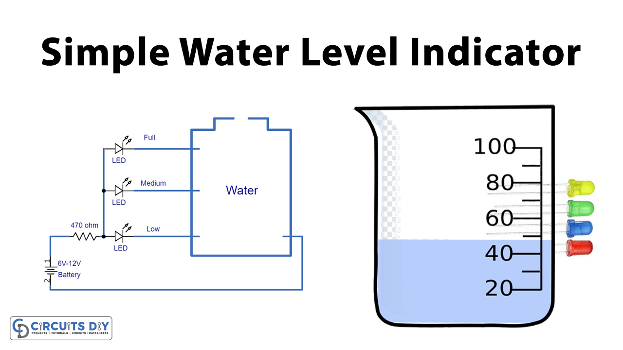
COMPONENT FUNCTIONALITY
Sensors: Detect water levels.
Switch: Turns on the circuit at a specific water
level.
Buzzer: Alarms at critical water levels.
Power Supply: Powers the entire circuit.

Slide 8
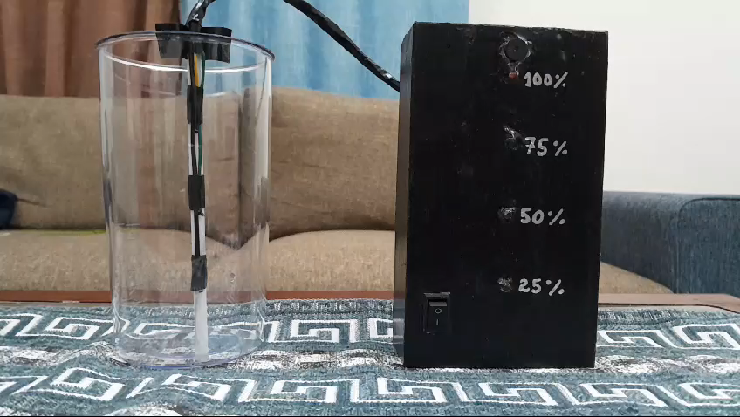
DEMO VIDEO

Slide 9
CONCLUSION
Summary: Our project effectively monitors and displays water levels, preventing overflow and ensuring an adequate water supply.
Benefits: Cost-effective, low maintenance, and provides real-time monitoring.
Future Improvements: Integration with IoT for remote monitoring, using more advanced sensors for higher accuracy.

Slide 10


